Slide 1
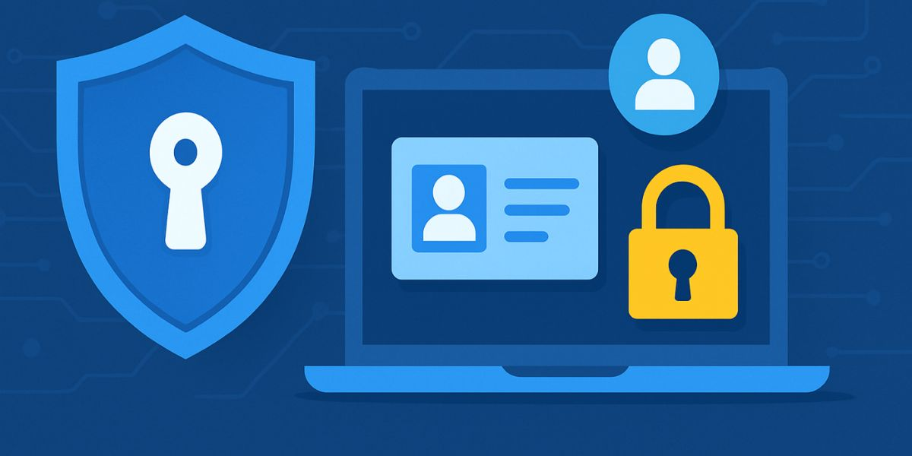
Cyber Security Awareness Program
Research Project
Zero Trust Identity Framework for Cloud Security

Slide 2
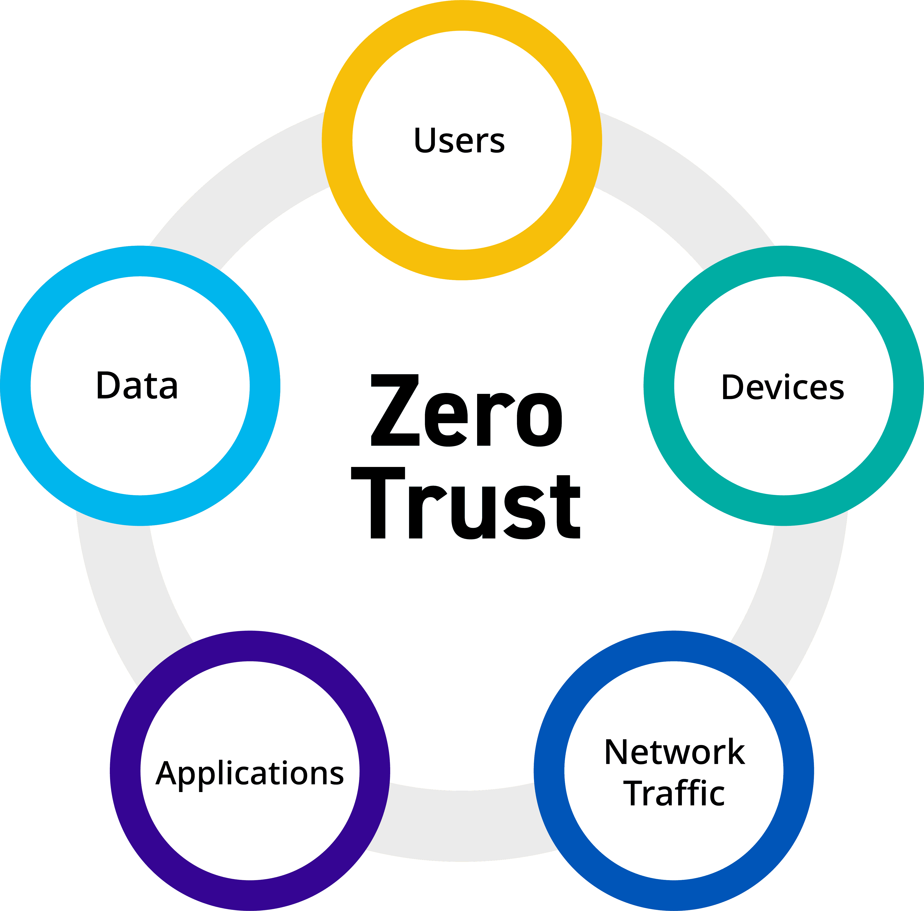
Introduction
Zero Trust redefines this approach by assuming Trust No One — Always Verify. It continuously verifies every user, device, and access request, regardless of location.
Focus of the Research: This project explores how Zero Trust principles can strengthen Identity and Access Management (IAM) in cloud environments to protect against data breaches and unauthorized access.

Slide 3
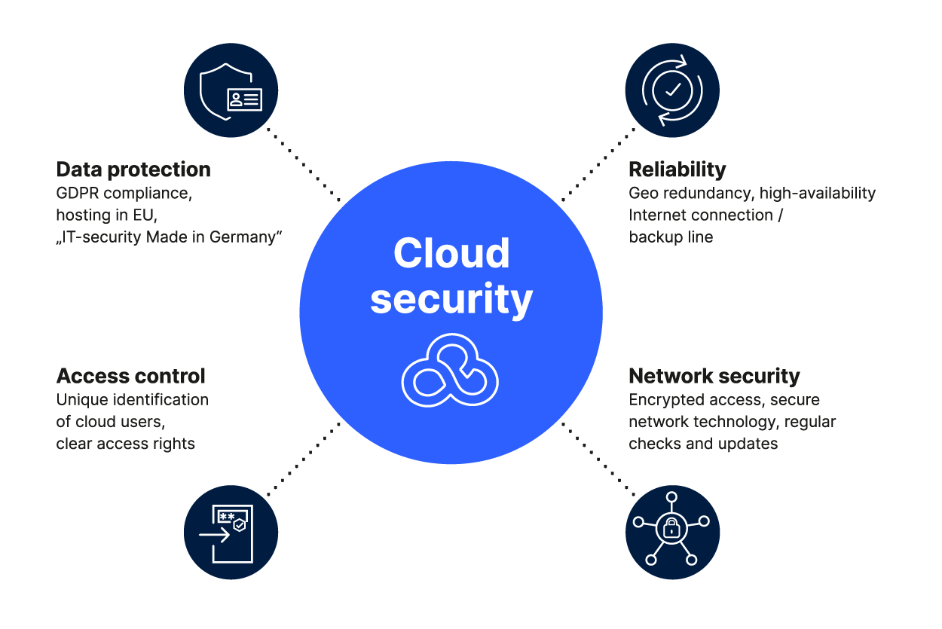
Cloud Security
Cloud Security involves protecting data, applications, and infrastructure hosted in the cloud from threats such as:
Unauthorized access
Misconfiguration
Data leaks
Insider attacks
It follows a shared responsibility model:
Cloud Provider: Secures the infrastructure
Customer: Secures access, data, and identities

Slide 4
Zero Trust Security
Zero Trust is a cybersecurity framework built on the principle of Never Trust, Always Verify.
It means:
No user or device is trusted automatically — inside or outside the network.
Every access request is verified continuously using strong authentication, authorization, and monitoring.
Core Principles
Verify Explicitly – Authenticate and authorize based on all data points (identity, device, location).
Use Least Privilege Access – Give users the minimal level of access needed.
Assume Breach – Always monitor and prepare as if the network is already compromised.

Slide 5
Identity as the Foundation of Zero Trust
In cloud environments, identity is the new perimeter — not firewalls.
Identity controls include:
Authentication: Passwords, Biometrics, Multi-Factor Authentication (MFA)
Authorization: Role-Based Access Control (RBAC), Policy-Based Access
Identity Federation: Single Sign-On (SSO) across cloud services
Privileged Access Management (PAM): Protects admin and high-level accounts
Example:
When a user logs into a cloud service (like Microsoft Azure), Zero Trust checks:
User identity
Device health
Network location
Risk score (based on previous behavior)
Only if all checks pass, access is granted.

Slide 6
Practical Zero Trust Habits for Everyday Users
Zero Trust for Users (Identity & Access Protection)
Identity Protection
Use strong, unique passwords for each account.
Use a password manager (Bit warden, 1Password, etc.).
Enable MFA or biometric authentication.
Never share login details — even with IT support.
Cloud & Data Access
Check who has permission before sharing files (Google Drive, OneDrive, Azure).
Avoid logging in from public/shared devices.
Always sign out properly from VPN or corporate networks.
💡 Tip: Identity is your first line of defense — protect it like your digital fingerprint.

Slide 7
Practical Zero Trust Habits for Everyday Users
Zero Trust for Users (Device & Behaviour Security)
Device Trust
Keep all devices patched and updated.
Install apps only from trusted sources.
Use encryption and screen lock on phones and laptops.
Awareness of Phishing & Social Engineering
Don’t click suspicious links or attachments.
Always verify the sender through another channel.
Watch for red flags: misspellings, fake domains, urgency.
Continuous Verification
Regularly check logged-in devices.
Sign out old or unused sessions.
Review app permissions every few months.
Remember: Trust nothing, verify everything — that’s the Zero Trust mindset!

Slide 8
Expected Outcomes
Improved access control and reduced risk of identity theft.
Increased awareness of Zero Trust principles in cloud environments.
Framework to guide organizations transitioning from perimeter-based to Zero Trust models.
Better compliance with standards like ISO 27001, GDPR, and NIST 800-207.

Slide 9
Conclusion
Zero Trust is not a product — it’s a security mindset.
By focusing on identity, continuous verification, and least privilege, organizations can secure their cloud environments against modern cyber threats.
In a Zero Trust world, identity is the new firewall — protect it relentlessly.

Slide 10

Awareness Message
Use strong, unique passwords
Enable multi-factor authentication
Be cautious with links and emails
Keep systems and devices updated
Remember: Security starts with you!

Slide 11


